Slide 1







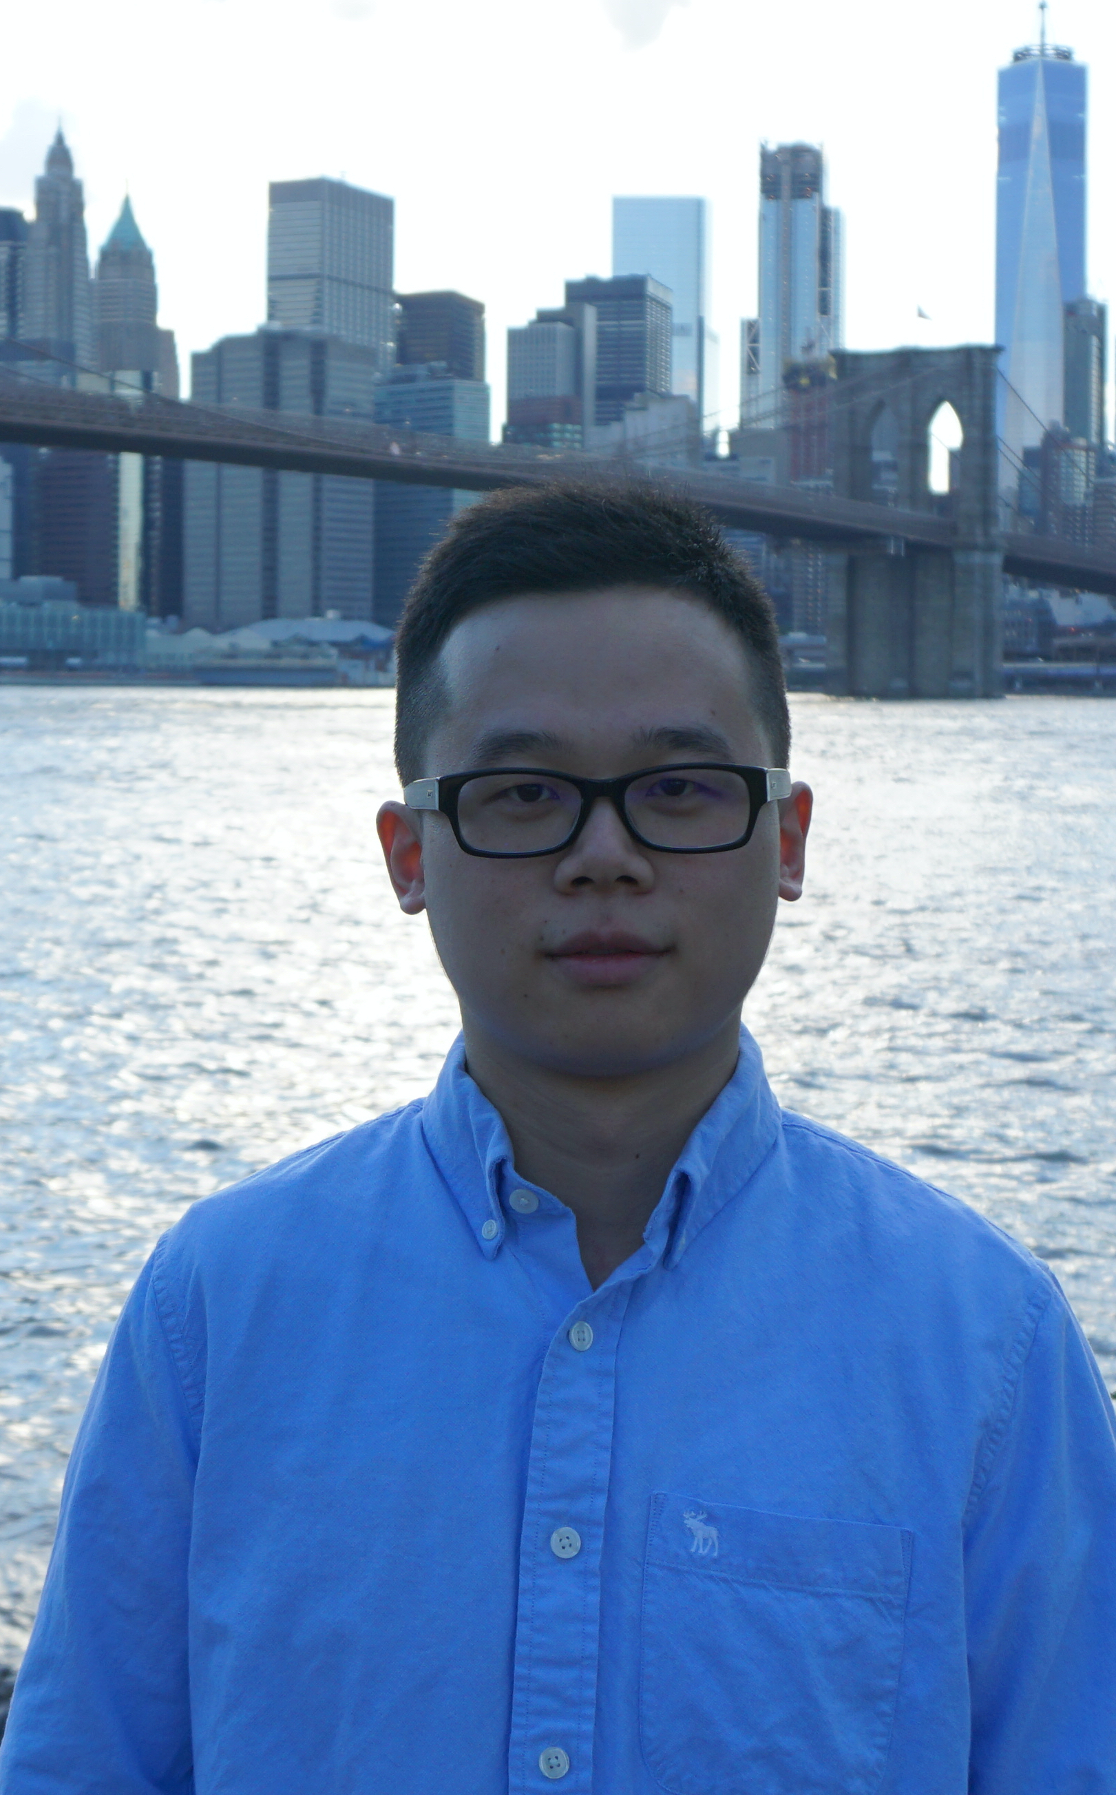
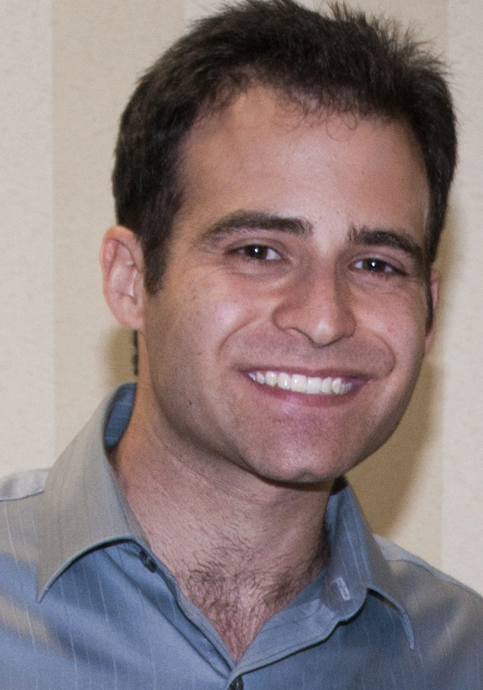

Semi-supervised 3D Object Detection via Temporal Graph Neural Networks
¹CMU RI
²Honda Research Institute
³CMU MLD
⁴National Chiao Tung University
Jianren Wang¹
Yi-Ting Chen⁴
David Held¹
Jianren Wang¹
Haiming Gang²
Siddharth Ancha³
Notes:
Hello Everyone, I am Jianren Wang from CMU. Today I am going to talk about “Semi-supervised 3D Object Detection via Temporal Graph Neural Networks”. This is joint work with Haiming, Sid, Yi-Ting and David Held.

Slide 2
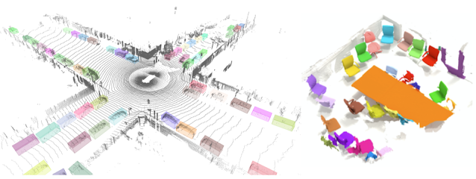
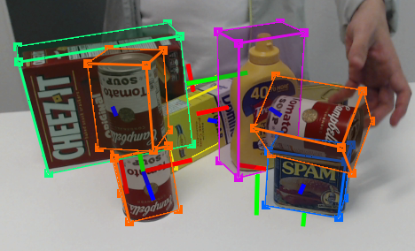
3D Object Detection
Fundamental In:
Autonomous Driving
Manipulation
AR/VR
Notes:
In this work, we focus on 3D object detection, which is an essential and fundamental problem in autonomous driving, object manipulation and augmented reality. In recent years, many approaches have emerged and achieve high performances on various benchmark datasets.

Slide 3

3D Object Detection
However
· Supervised -> Large amount of annotation
· Labeled 3D annotations -> Difficult and time consuming
Notes:
Despite the impressive performances, most of the existing approaches are strongly supervised and require the availability of a large amount of well-annotated 3D data. Labeled 3D annotations are always time-consuming and expensive to collect

Slide 4
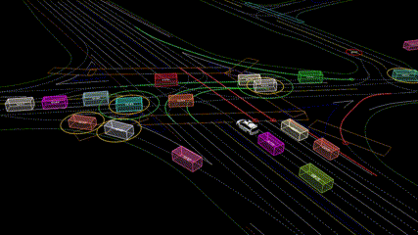
3D Object Detection
On the other hand
· Point Cloud Videos -> Cheaply Available
· Point Cloud Videos -> Contains richer spatiotemporal information
· Can we utilize this information to improve a single frame 3D object detector?
Yes, Semi-supervised training!
Notes:
On the other hand, in most applications, point clouds are recorded over time as a data stream. A point cloud video contains richer spatio temporal information than a single frame.

Slide 5
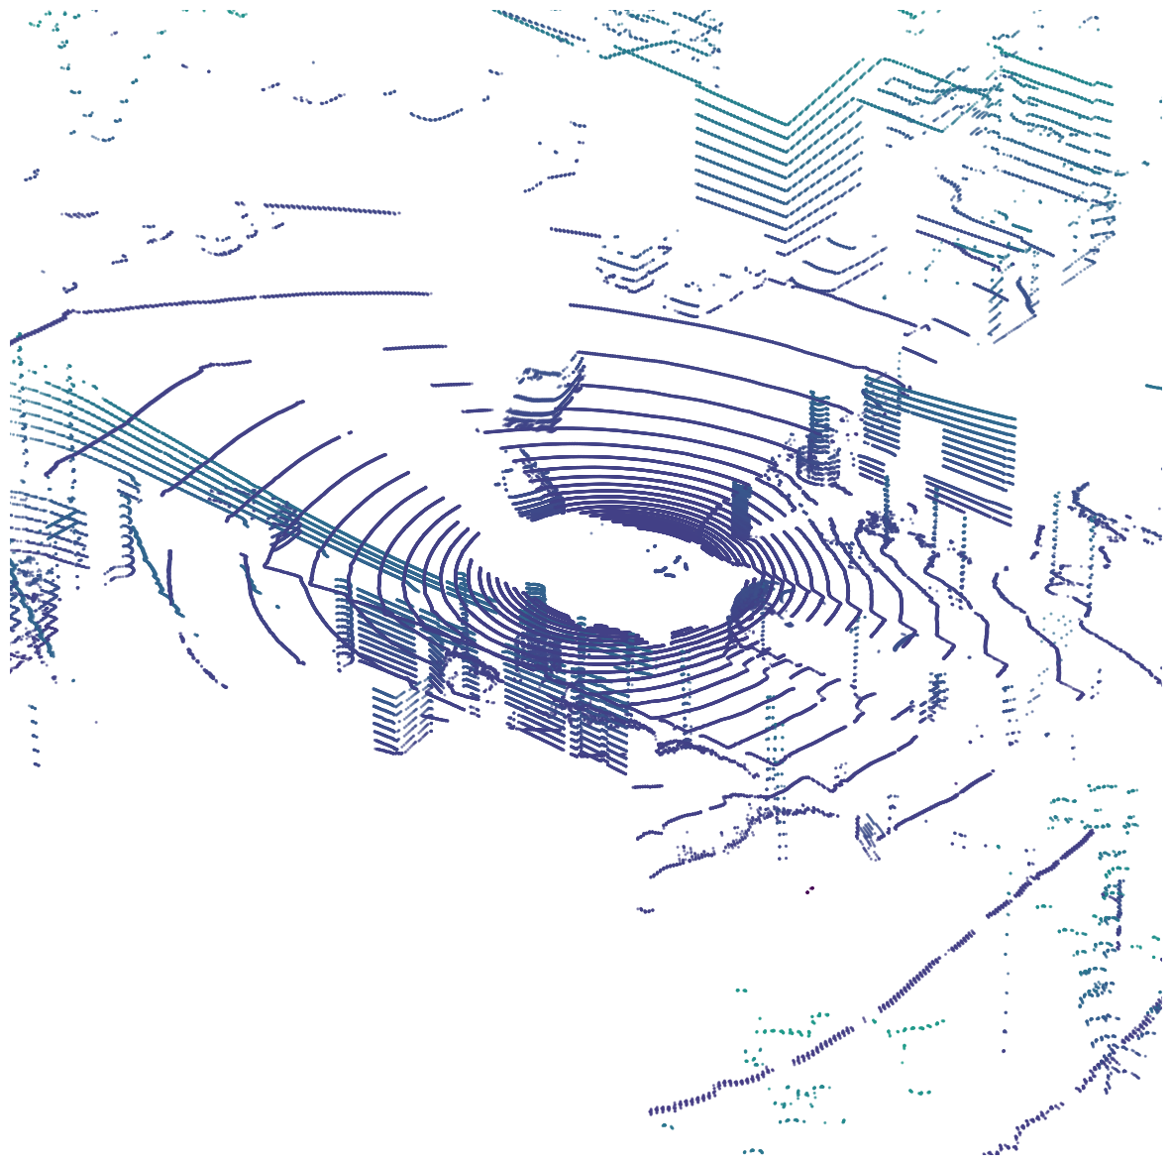
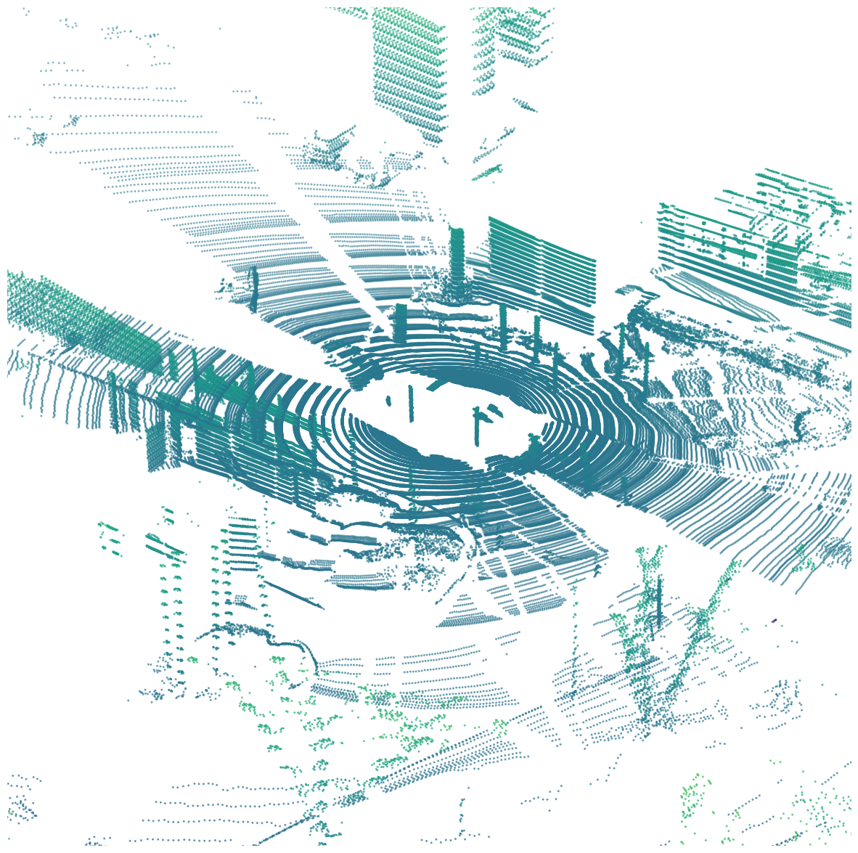



Method: Overview
$$t−1$$
$$t$$
$$t+1$$
Notes:
Here is an overview of our proposed method.

Slide 6
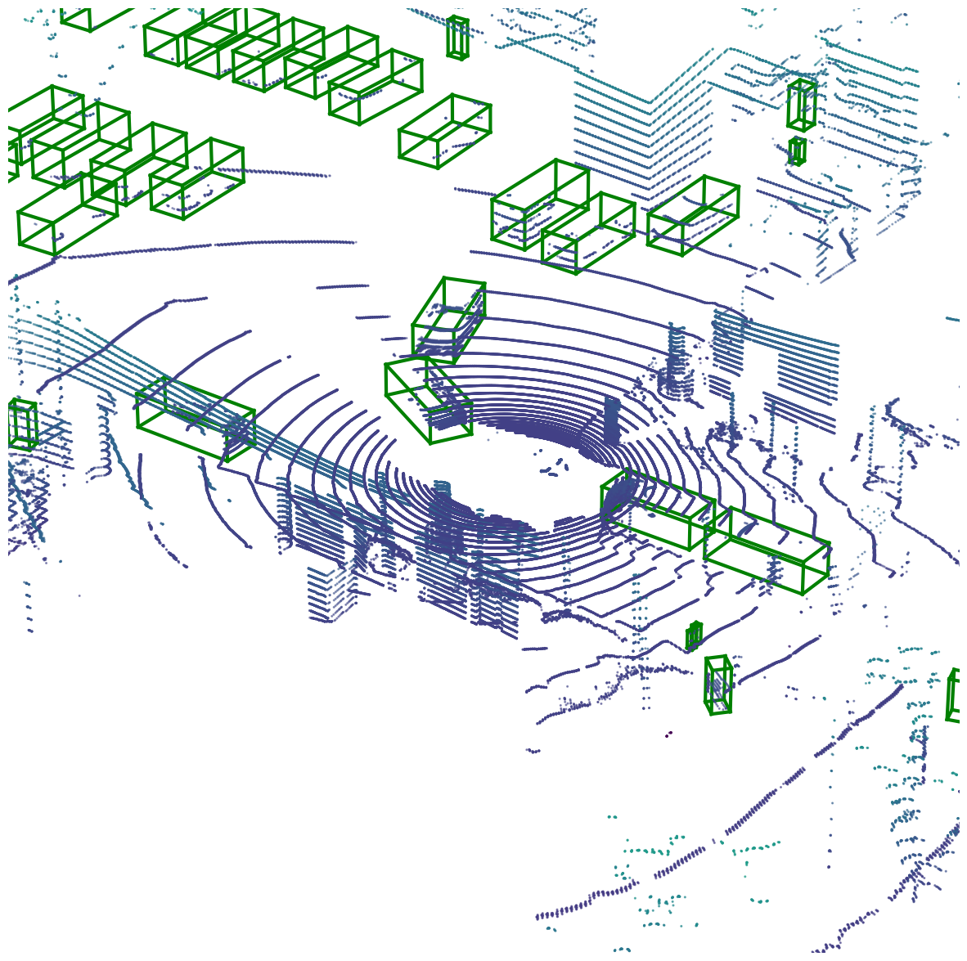
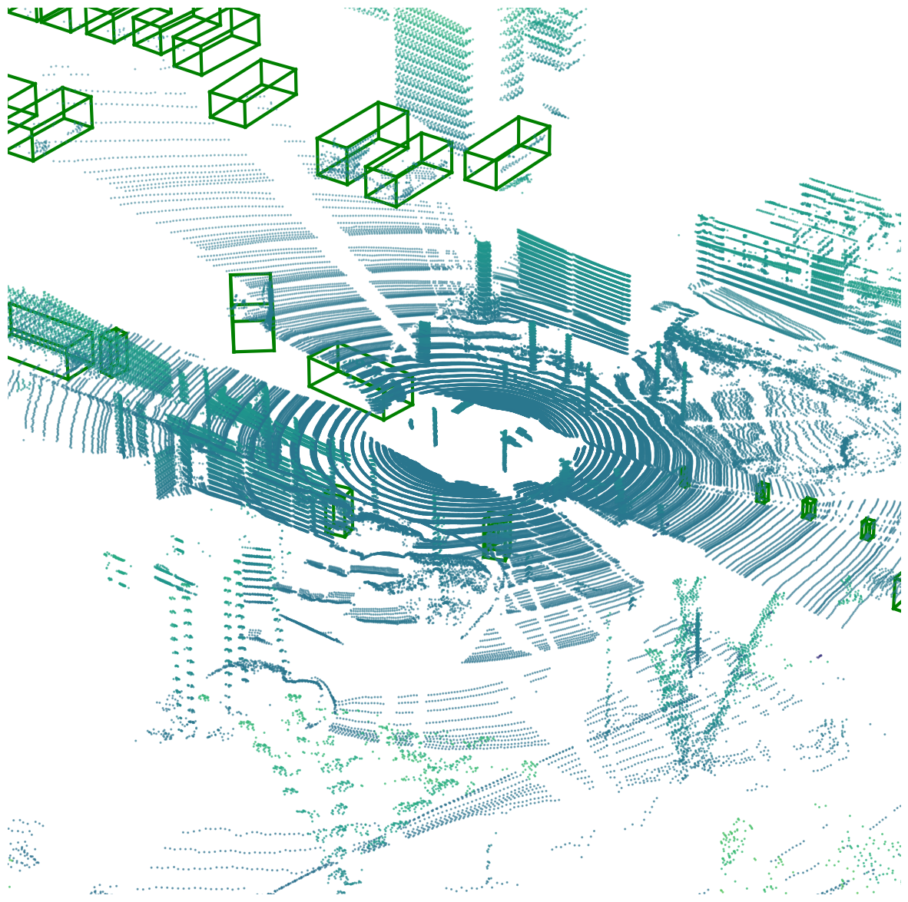
Method: Overview
Detector
Detector
Detector
$$t−1$$
$$t$$
$$t+1$$
Notes:
Given a pretrained 3D object detector

Slide 7
Method: Overview
Spatiotemporal Reasoning
Teacher
Detector
Detector
Detector
$$t−1$$
$$t$$
$$t+1$$
Notes:
Our method consists of a teacher which performs spatiotemporal reasoning for 3D object detection

Slide 8
Method: Overview
Pseudo Label
Spatiotemporal Reasoning
Teacher
Uncertainty-aware Semi-supervised Training
Detector
Detector
Detector
Detector
Student
$$t−1$$
$$t$$
$$t+1$$
Notes:
This teacher is then used to provide pseudo labels to train a student which takes as input only a single frame. We use uncertainty-aware training to handle incorrect pseudo labels produced by the teacher.

Slide 9
Method: Overview
Pseudo Label
Spatiotemporal Reasoning
Teacher
Detector
Detector
Detector
Detector
Student
$$t−1$$
$$t$$
$$t+1$$
Update the teacher detector
Notes:
The detector is then updated to provide better detection candidates. The teacher and student can be updated alternatively to keep improving the performance.

Slide 10
Experiment Setups
Train:
3D object detector pre-trained with 50 scenes on nuScenes [1] train
500 scenes from nuScenes train for Semi-Supervised Training
150 scenes from nuScenes train as validation set (not overlapping with the 500 scenes for semi-supervised training)
Test:
150 scenes from nuScenes validation as test set
Metric: mAP
[1] Caesar, Holger et al. “nuScenes: A multimodal dataset for autonomous driving.”, CVPR2020

Slide 11
Results: Baselines
[1] Teichman, Alex et al. “Tracking-based semi-supervised learning.”, IJRR2012
[2] Zhao, Na et al. “Sess: Self-ensembling semi-supervised 3d object detection.”, CVPR2020

Slide 12
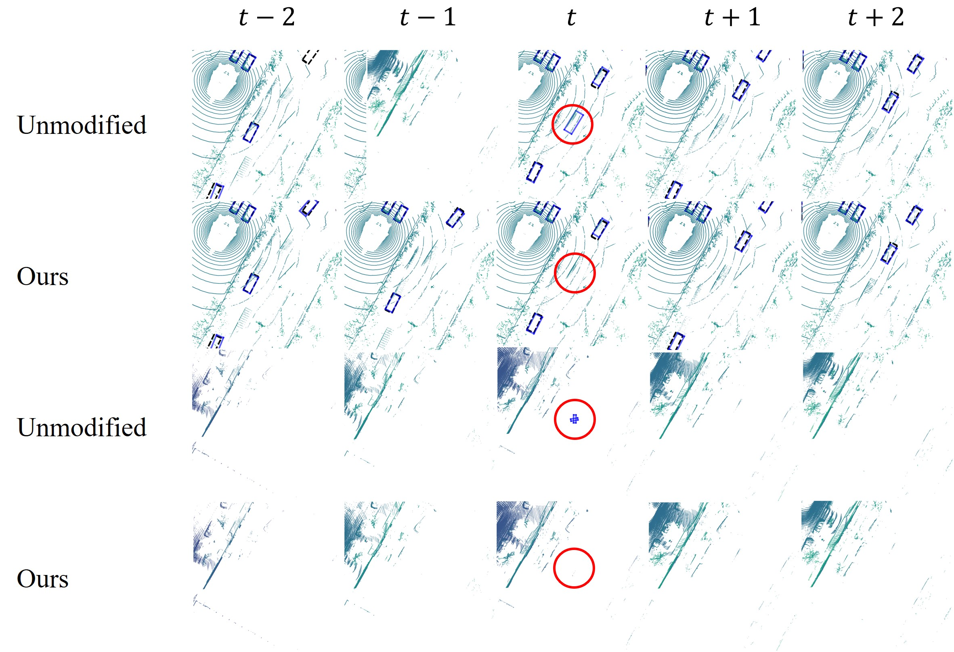
Results: Qualitative
Student
Ours
Student
Ours
Correct False Positive
Notes:
Here we show our method successfully correct the false positive.

Slide 13
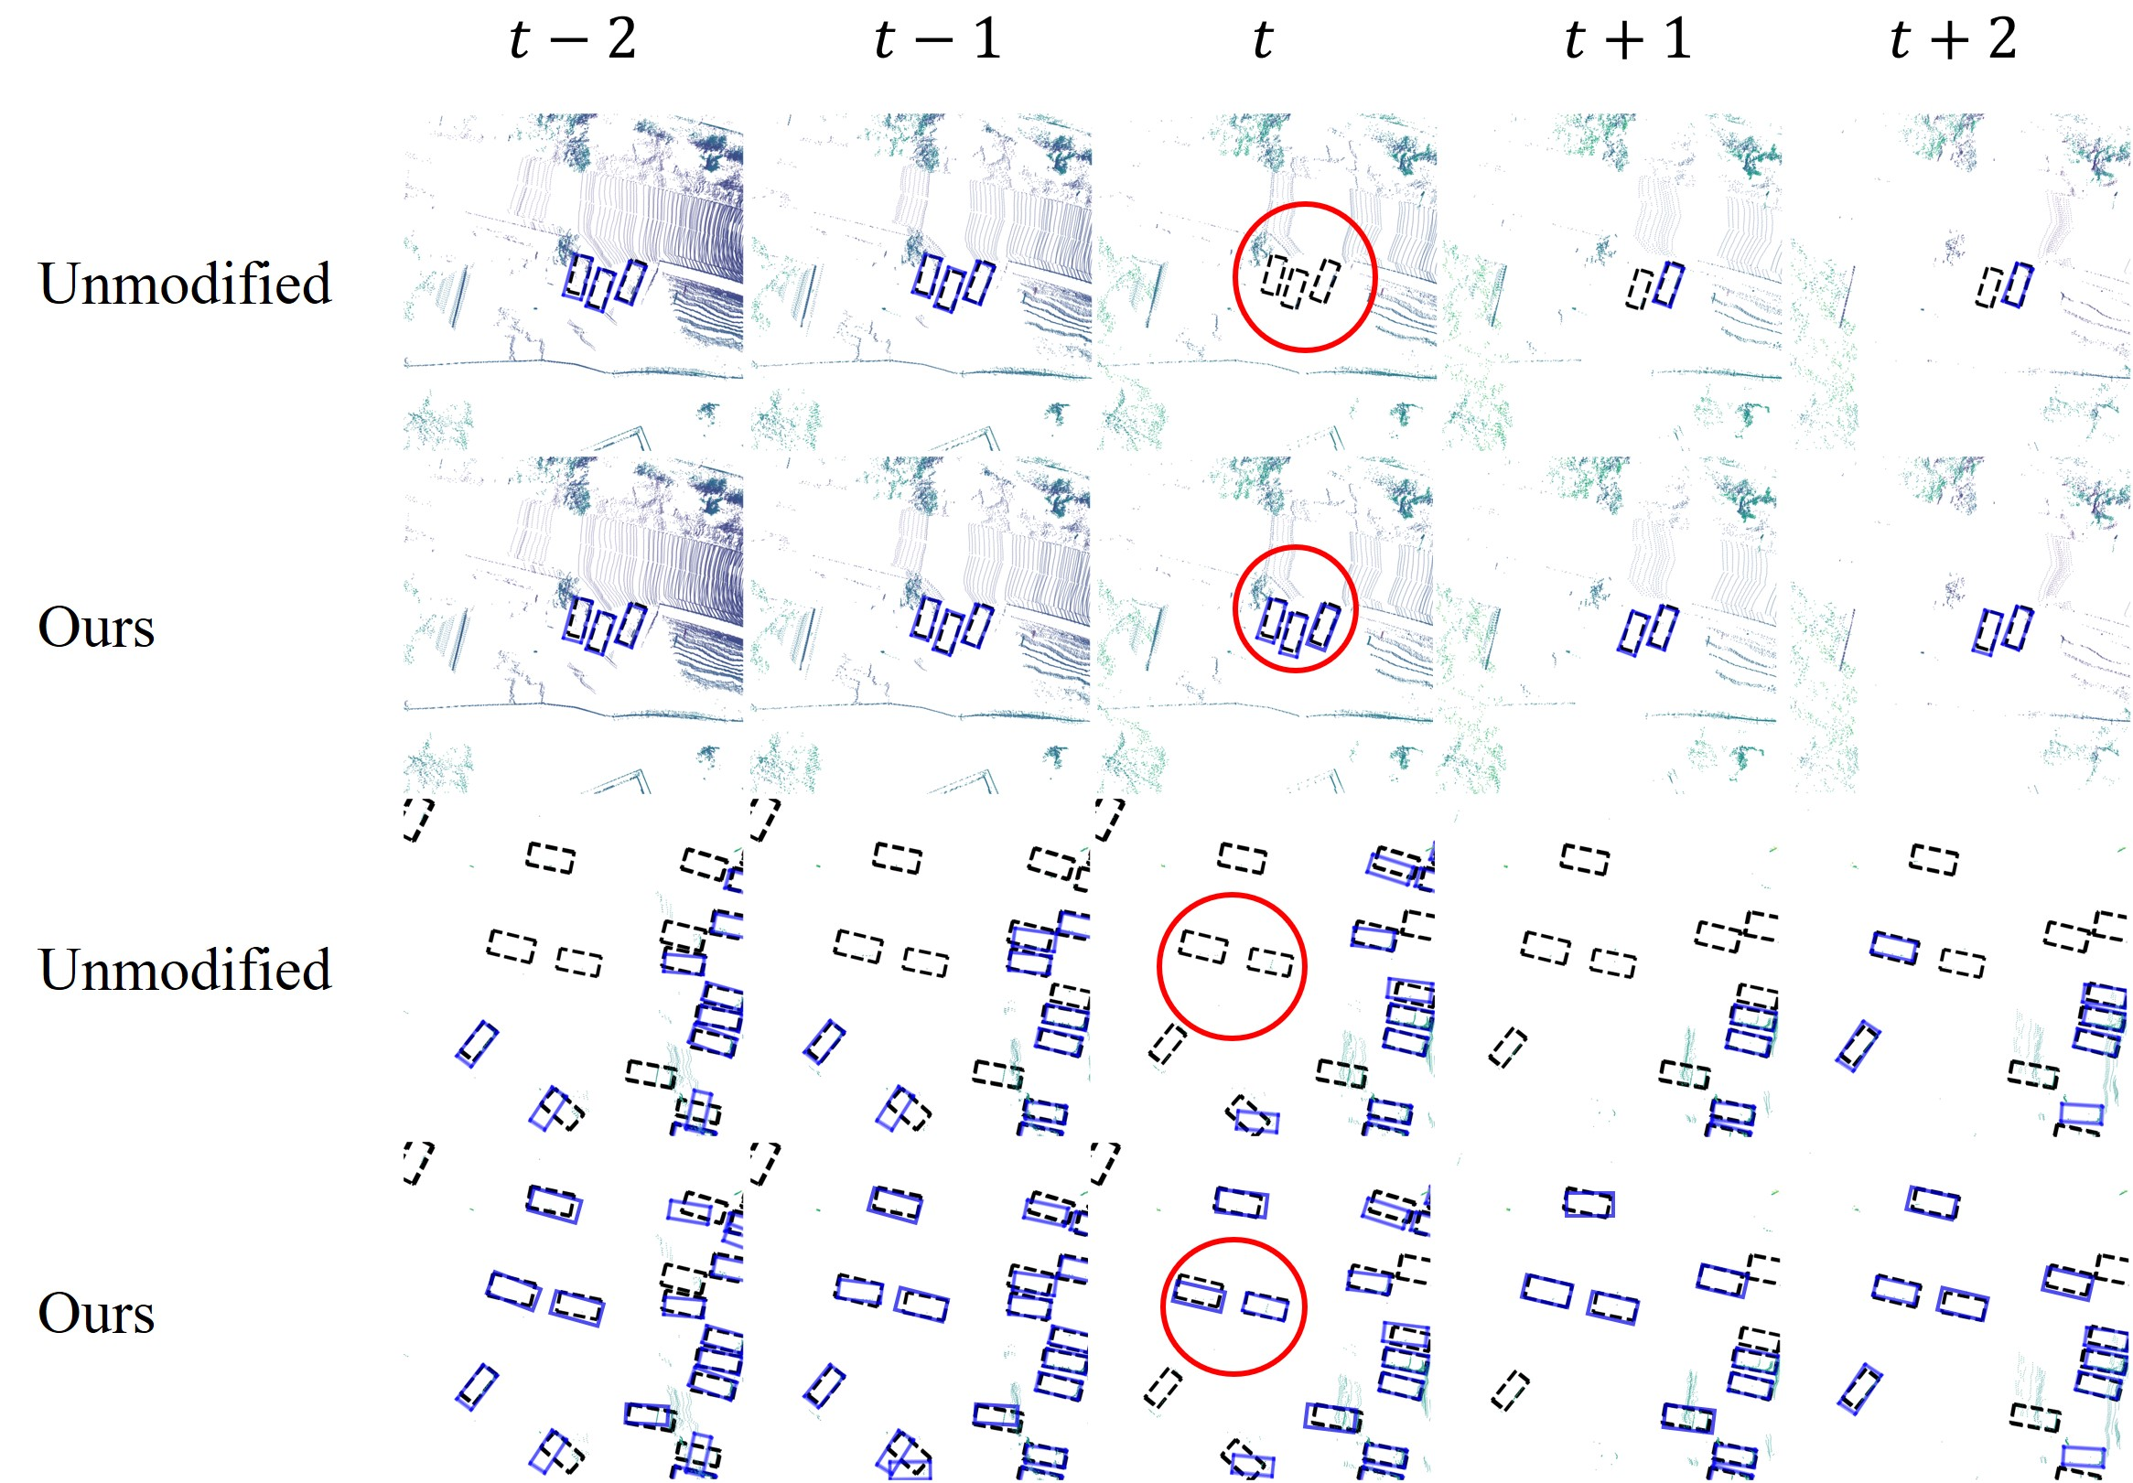
Results: Qualitative
Student
Ours
Student
Ours
Correct False Negative
Notes:
Here we show our method successfully correct the false negative.

Slide 14

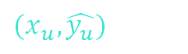
Conclusion
We propose to leverage unlabeled point cloud videos by semi-supervised learning.
Our method incorporates uncertainty-aware semi-supervised training with a GNN for spatiotemporal reasoning
Our method achieves state-of-the-art detection performance on the challenging nuScenes and H3D benchmarks
Our method removes the need for excessive efforts in data annotation
Pseudo Labeled Data
$${(x}_{u},\hat{y_{u}})$$
Temporal GNN
Detector
Better Candidates

Slide 15
Thank you
Conclusion
We propose to leverage unlabeled point cloud videos by semi-supervised learning.
Our method incorporates uncertainty-aware semi-supervised training with a GNN for spatiotemporal reasoning
Our method achieves state-of-the-art detection performance on the challenging nuScenes and H3D benchmarks
Our method removes the need for excessive efforts in data annotation
Pseudo Labeled Data
$${(x}_{u},\hat{y_{u}})$$
Temporal GNN
Detector
Better Candidates

